Slide 1
Stern data bootcamp Session 1
2022-02-02

Slide 2
Agenda
Introduction
Python fundamentals

Slide 3
Context and objectives
This class is the NYU Stern data bootcamp
Objectives:
Explain why we’re here so you can decide whether this is the class for you
Preview the next 13 weeks
Install the software you’ll need for the class
Run your first programs

Slide 4
How would you create a chart like this?

Slide 5
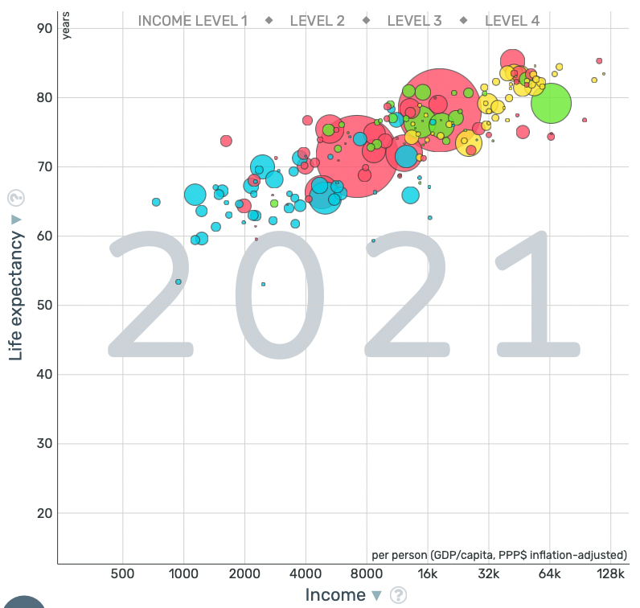
How would you create a chart like this?

Slide 6
How would you answer these questions?
How many prime numbers are less than 10?

Slide 7
How would you answer these questions?
How many prime numbers are less than 1,000,000?

Slide 8
How would you answer these questions?
How many prime numbers are between 1,000,000 and 22,857,113?

Slide 9
The real reason we’re here
The title of the class is Data Bootcamp, and it will indeed be a hands-on, practical introduction to Python and other tools for modern data analysis
But the fundamental value of this course is simple: coding is a skill that, like writing, has the power to change your life for the better.

Slide 10
One more note
Remember that this class is built with students with no prior coding experience in mind
You will encounter challenges every week that will stretch your abilities, but you will be graded primarily on conceptual understanding, not on deploying enterprise-level code

Slide 11
What’s in it for you?
Fluency in data analysis norms and techniques is high variance
It is also a high weight attribute in the eyes of employers
Obtaining this skill – even at what you might consider a low level – will differentiate you from your peers
Variance
Quirks
Different levels of skill are evident but not valued
e.g., writing in cursive
Valuable differentiators
Different levels of skill are both evident and critical
e.g., data analysis
Wastes of time
No one cares or can differentiate among different levels of skill
e.g., perfectly-ironed socks
Table stakes
Skill is important but everyone is at about the same level
e.g., showing up on time
Weight

Slide 12
Kaplan interlude
Using code to change how a job could be envisioned

Slide 13
The real reasons to learn to code
Conventional wisdom: programming languages can handle much larger datasets than Excel
Truth: your system’s memory is the limiting factor, and while Excel does use it a bit less efficiently, this is rarely a real bottleneck
However, programming languages much more naturally interface with databases, which do contain much more data than your machine, or an Excel workbook, could ever handle

Slide 14
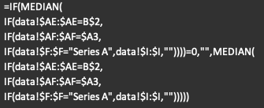
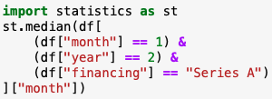
The real reasons to learn to code
Conventional wisdom: a small amount of code accomplishes what would require a nightmarish Excel formula
Truth: for a lot of tasks, the code is going to be just as complex as the Excel formula would be – “one line of code to invent Facebook” is greatly overblown
However, code written to accomplish something hard is much easier to debug, expand, rewrite, and reuse once you’re fluent in the coding language

Slide 15
The real reasons to learn to code
Conventional wisdom: my company’s analysts and data scientists are responsible for data extraction and analysis, and they are the experts
Truth: they are experts, but even experts make mistakes, and they often lack domain knowledge. Your fluency in data analysis and techniques will help all your work with colleagues proceed more smoothly.

Slide 16
Tools we will use You will not need to be an expert in all of these
Python programming language
The environment in which we’ll write Python is called Google Colab (it’s free)
You can also install the Jupyter development environments to work on your machine with no internet
MySQL database query language
GitHub
Code repository that is the global standard for sharing and open-sourcing code
ChatGPT
Provides great starting points and explanations for many coding problems; accelerates development
Google
Often the quickest way to get to StackOverflow, with which you will become very familiar

Slide 17

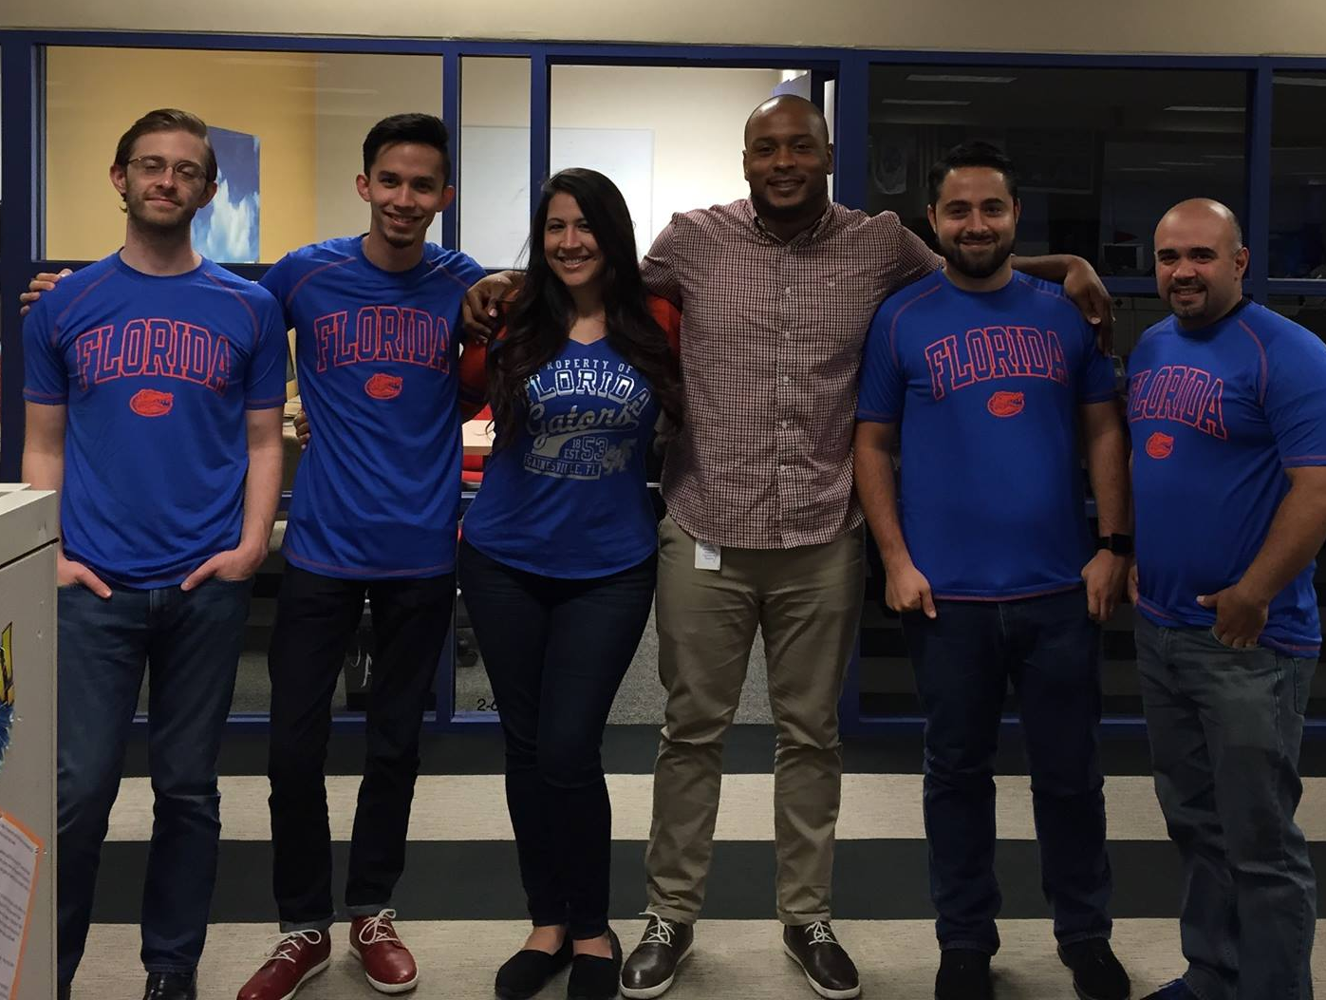



Jack of like, two or three trades Master of none
2007 – 2013
Orchestral music
2013 – 2017
Test prep
2017 – 2022
Business
2022 – present
Life sciences

Slide 18
Bain interlude
Using code to make my life just a little easier

Slide 19
Where is this stoking your imagination?

Slide 20
Agenda
Introduction
Python fundamentals

Slide 21
Keep your eye out for data you want to work with
You’ll need datasets for your midterm and final projects
Ideal datasets for this class are:
Pretty big
Genuinely interesting to you
Able to convey insights that are actually interesting (not just, “the average home price was X”)
A little unusual / on a topic off the beaten path
Comprised of different data types (i.e., some columns are numbers, some are text, etc)
If you’re unsure or just want to talk it over, schedule some time with me

Slide 22
Python fundamentals Getting started
For this class, we will use Google Colab
Colab is a standard development environment for Python “notebooks”
Notebooks are live development environments where you can write and execute code all in one place
Please type along as I code on the board
Ask questions as we go

